Slide 1
Json, JAVASCRIPT data storage and Functions in Detail
IN712 Web 3

Slide 2
File formats for Data Storage and Transmission in Javascript
As a web developer you often need to store data as well as transmit data to other computers and systems
You can’t just store/transmit Javascript objects and arrays
Instead, you need to serialize them
Serialization is the process of translating an object into a string representation of that object
Once an object is serialized, the string representation of that object can then be stored in a more permanent storage facility or transmitted to another computer
When you need to work with the serialized object within JavaScript, you need to deserialize it, converting the string representation of the object back into a native JavaScript object

Slide 3
XML
There was a time when the web development community embraced XML markup language for everything
Web services used it to communicate with one another and other computers, and JavaScript developers used it to store data and to communicate with the web application’s server
XML is a human‐readable language thanks to its declarative syntax
XML has its drawbacks.
XML’s declarative syntax adds a lot of extra cruft to the data
Lots of code necessary for reading, parsing, and generating XML data

Slide 4
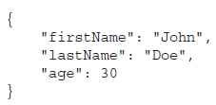
JSON
JSON stands for JavaScript Object Notation, and it's a text format that makes it easy to share data between devices like clients and servers
JSON uses several of JavaScript’s syntactical patterns for organizing and structuring data
It’s extremely easy to parse JSON into JavaScript objects and to serialize objects into JSON
In recent years, JSON has gotten so popular that companies like Twitter have even chosen to discontinue support for XML output of their API streams
JSON looks a lot like JavaScript’s object and array literals.
JSON lets you represent three types of data
Simple Values: strings, numbers, booleans, and null
Objects
Arrays

Slide 5
JSON Objects
Objects in JSON are represented with what looks like JavaScript’s object literal notation.
Remember that JSON is a data format, not a language
Object’s property names are surrounded by double quotes.
Notice the lack of a trailing semicolon after the closing curly brace
Javascript
JSON

Slide 6
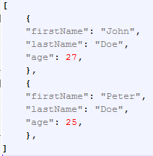
JSON Arrays
Like objects, arrays in JSON are similar to JavaScript’s array literal notation
Javascript
JSON

Slide 7
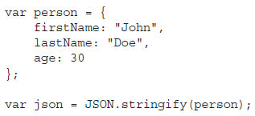
Serializing into JSON
It’s extremely easy to serialize JavaScript objects into JSON. JavaScript has an aptly named global JSON object
All major browsers support this JSON object
To serialize a JavaScript object into JSON, you use the JSON object’s stringify() method.
The json variable can now be used to send data to the server, store data locally…

Slide 8
Parsing JSON
Parsing JSON into JavaScript objects is simple.
The JSON object has a parse() method that returns the resulting object.
Using the json variable from the previous code:

Slide 9
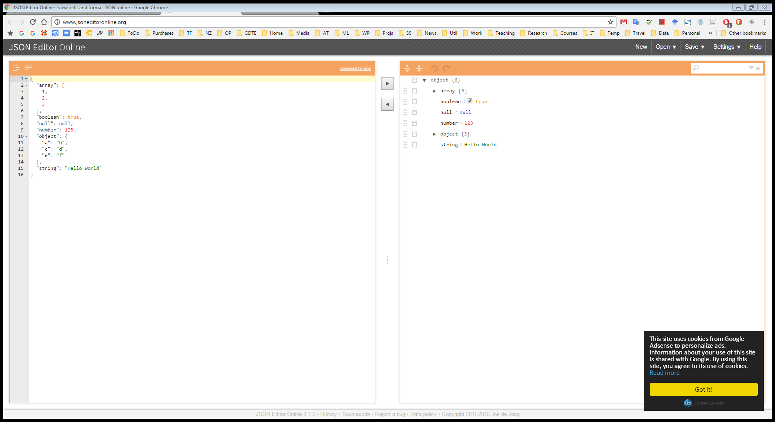
Online JSON editor
{
"array": [
1,
2,
3
],
"boolean": true,
"null": null,
"number": 123,
"object": {
"a": "b",
"c": "d",
"e": "f"
},
"string": "Hello World"
}

Slide 10
Data Storage
Our goal as website programmers should be to make the website experience as easy and pleasant for the user as possible
One way of doing this is learning about your users and using information gained about them to personalize the website
Imagine a user, whose name you asked on the first visit, returns to your website.
You could welcome a user back to the website greeting by name.
By already knowing the user’s purchasing details, such as credit‐card number and delivery address, you can allow the user to go from viewing an item to buying it in just one click,
Based on information, such as the previous purchases and browsing patterns of the user, recommendations can be made

Slide 11
Data Storage
Such personalization requires that information about users be stored somewhere in between their visits to the website
Accessing the user’s local filesystem from a web application is pretty much off limits because of security restrictions included in browsers
However, as a website developer you can store small amounts of information
in a special place on the user’s local disk, using what is called a cookie
in the browser using HTML5’s Web Storage

Slide 12
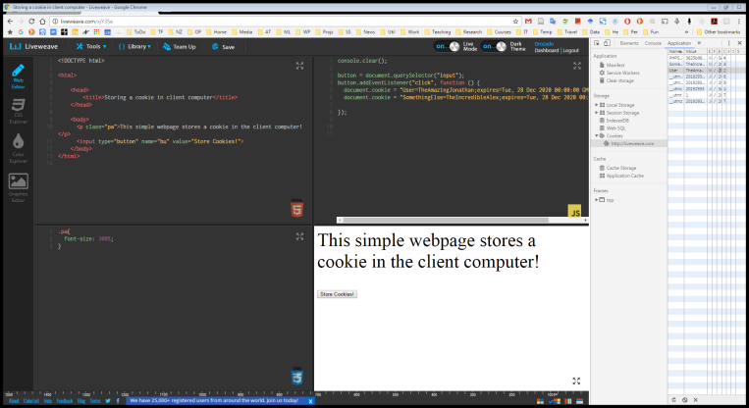
Cookies
Cookies are stored on client computers by websites visited by web users and contain information such as site preferences or login status.
The key to cookies is the document object’s cookie property.
Using this property, you can create and retrieve cookie data from within your JavaScript code.
Cookies are always associated with a given domain
You can set a cookie by setting document.cookie to a cookie string.

Slide 13
The Cookie String
When you are creating a cookie, you can set six parts:
Name
Value
Expires
Path
Domain
Secure
The latter four of these are optional

Slide 14
Name and value
The first part of the cookie string consists of the name and value of the cookie.
The name is used so that you can reference the cookie later
The value is the information part of the cookie.
This name/value part of the cookie string is compulsory
The value for the cookie is a primitive string
semicolons are used to separate the different parts of the cookie within the cookie string.
By default cookies have a very limited lifespan (i.e. the length of time the information will continue to exist.)
If you don’t set an expiration date, a cookie will expire when the user closes the browser.

Slide 15

expires
If you want a cookie to exist for longer than just a single user session, you need to set an expiration date using the second part of the cookie string, expires
The format of the expiration date is very important. It should be the same format the cookie is given by the toUTCString() method.
In practice, you’ll probably use the Date object to get the current date, and then set a cookie to expire three or six months after this date.

Slide 16
path
cookies are specific to a particular web domain, such as www.op.ac.nz ,
Cookiess are also specific to a particular path on that domain.
For example, if a page in www.op.ac.nz/students/ sets a cookie, only pages in that directory or its subdirectories will be able to read and change the cookie.
If a page in http://www.op.ac.nz/enterprise/ tried to read the cookie at www.op.ac.nz/students/, it would fail.
what if you want to view your cookies from two different paths on your server?

Slide 17
path
Say, for example, you have an online store at www.wine.com/mystore/
you subdivide the store into subdirectories, such as www.wine.com/mystore/Red and www.wine.com/mystore/White
You can use the path part of the cookie string to specify that the path of the cookie is /mystore even if it’s being set in the www.wine.com/mystore/Red subdirectory
That way, the cookie will be made available to any page or subfolder beneath the /mystore (i.e /mystore/Red, /mystore/White, etc )

Slide 18
domain
By default, cookies are available only to pages in the domain in which they were set.
For example, if you have a website running on a server with the domain http://wine.com and you have a second website running under http://beer.com a cookie set in one website will not be available to pages accessed under the other domain name, and vice versa
The same applies to subdomains, if you have your first website running on a server with the domain http://red.wine.com and you have a second website running under http://white.wine.com, a cookie set in one website will also not be available to pages accessed under the other domain name, and vice versa.
Most of the time, this is exactly what you want, but if it is not, you can use the domain part of the cookie string to specify that a cookie is available to all subdomains of the specified domain.

Slide 19
secure
The secure flag is an option that can be set by the application server when sending a new cookie to the user within an HTTP Response
The purpose of the secure flag is to prevent cookies from being observed by unauthorized parties due to the transmission of the cookie in clear text.
To accomplish this goal, browsers which support the secure flag will only send cookies with the secure flag when the request is going to a HTTPS page. Said in another way, the browser will not send a cookie with the secure flag set over an unencrypted HTTP request.
By setting the secure flag, the browser will prevent the transmission of a cookie over an unencrypted channel.
The secure property is simply a boolean value
The default value, which is false, means the cookie will always be sent, regardless of the security.
This is only applicable where you have set up a server with SSL/TLS (HTTPS).

Slide 20
Getting a Cookie’s Value
The cookies are retrieved in name/value pairs, with each individual cookie separated by a semicolon
The expires, path, domain, and secure parts of the cookie are not available to you and cannot be retrieved
The document.cookie property enables you to retrieve only all the cookies set for a particular path within a domain and there’s no simple way of just getting the value of a cookie with the name Age.
To do this you’ll have to use the string manipulation techniques

Slide 21
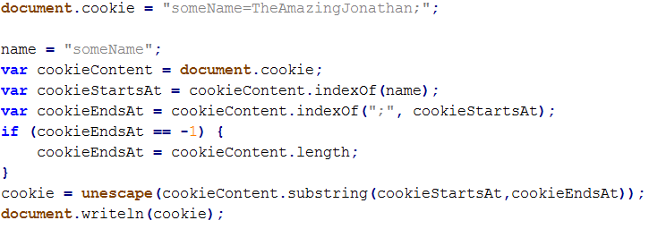
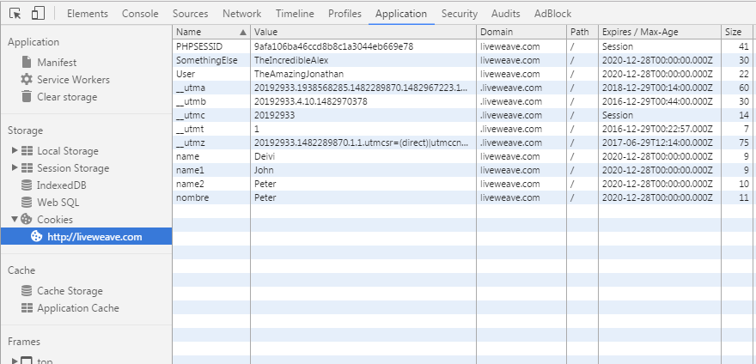
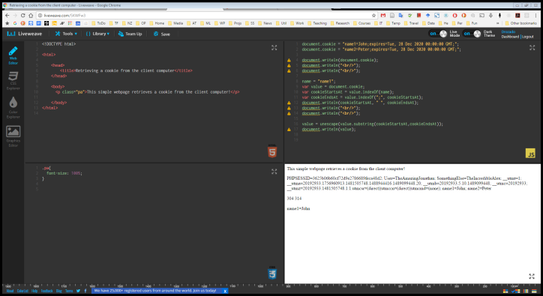
Getting a Cookie’s Value and Checking cookies visually in the browser

Slide 22
Cookie limitations
A user may disable cookies
Reading a cookie is convoluted ( requires a lot of code )
Number and information limitation
Browsers set up upper limits for the number of cookies a domain can store
Each cookie pair ( the name and value of the cookie combined) must not be more than 4KB in size
Browsers also set up upper limits for the number of cookies ( from all sorts of domains) that they can store
When that limit is reached, all the cookies, regardless of the expiration date, are often deleted
Cookies are not a browser feature, but a feature of HTTP.
The browser sends them to the server on every request. This is useful for applications that live on the server, but it’s unnecessary for JavaScript that runs in the browser
Take home message:
Cookies can be useful
But they are a tool designed for a different time, the past (with a different web)
There is a better alternative for storage in modern web applications

Slide 23
Web storage
HTML5 introduced a new feature called web storage
Web storage has been moved out of the HTML5 specification and into its own (which is named Web Storage)
It solves each of cookies’ aforementioned problems
It stays within the browser and is not transmitted to the server.
It is storage for JavaScript developers
It provides significantly more storage space.
Chrome and Firefox support 5MB per domain
The data stored in local storage never expires
It remains until the developer or the user deletes it
It consists of two components:
Session storage
Local storage

Slide 24
Web storage
The data stored in web storage is associated with a unique name
we refer to this name as a key, and the data associated with a key is referred to as the value
we refer to the key and its value as a key/value pair
You access local/session storage using the localStorage and sessionStorage objects respectively
Web storage makes it easy to set, get, and remove data
We will focus on local storage, but you can apply the same concepts to session storage

Slide 25

Setting data with web storage
The localStorage object exposes a method called setItem(), and its purpose is to set a value associated with a given key

Slide 26
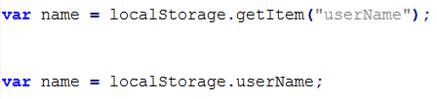
Getting data with web storage
Retrieving data from local storage is similarly straightforward

Slide 27

Removing data with web storage
You might want to remove some data that you stored in local storage

Slide 28

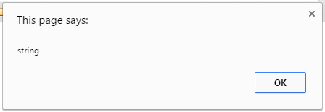
Note about storing data as strings
Web storage is a string‐only data store
If you try to store some other type of value (like a number) or object, it is converted to a string and stored as a string

Slide 29
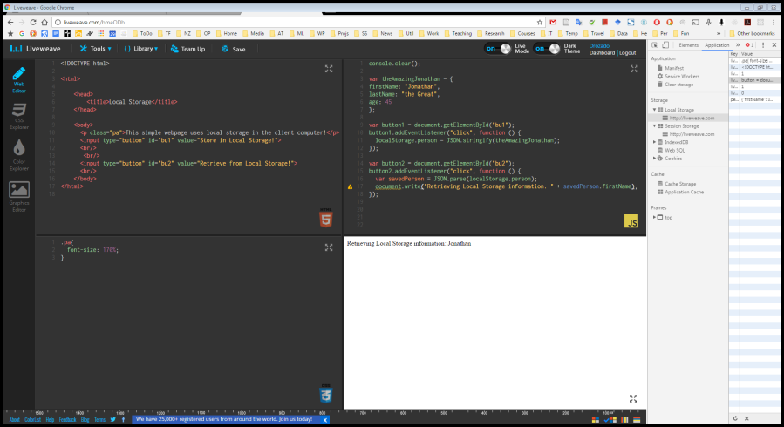
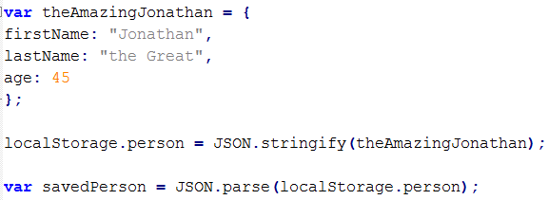
Note about storing data as strings
For storing complex objects
We need to serialize objects into JSON for storing them
We need to parse them back from JSON storage into actual objects when retrieving information.

Slide 30
Javascript functions – Advanced

Slide 31
Functions recap
A function is just a series of statements that are grouped together into a special package in JavaScript.
There's lots of ways of declaring, invoking, and manipulating functions, so it can get quite complicated
All functions are defined with the function keyword, regardless of how they are used or invoked.
Defining the function is sometimes called declaring the function
Before they can be used, all functions have to be declared or defined.
In JavaScript, the name of the function is sometimes optional
After the function name, you have a set of parentheses, and inside those, you can enter a series of parameters separated by commas
You can have zero or as many parameters as you want, and these will become variables that are local to and only available inside your function
In addition to returning a simple result, JavaScript can return an object or even another function.
In order to use the function, you'll need to call it within your code. This is sometimes called invoking the function
function plus(a, b) {
var sum = a+b;
return sum;
}
console.log(plus(2,2));

Slide 32
Declaring functions
Traditional declarations
Definition expressions
you can assign a function as the value of a variable or an expression.
This is sometimes called a function literal.
It's also known as an anonymous function.
it's called an anonymous function because you don't need to provide a name for it
function plus(a, b) {
var sum = a+b;
return sum;
}
console.log(plus(2,2));
var plus = function(a,b) {
var sum = a+b;
return sum;
};
console.log(plus(2,2));

Slide 33


Variable scope and global variables
var b = 'b';
function foo() {
console.log(b);
var a = 'a';
}
foo();
a;
One of the things that makes JavaScript confusing is how it determines variables scope.
Scope refers to when and where within your code a variable exists and retains a certain value.
In most programming languages, variables have a block scope.
Variables created in a code block or inside curly braces exist only inside those curly braces. They cease to exist outside them.
In JavaScript, we have something different called function scope.
In function scope, variables live within functions. Any variables you create with the keyword var are local to the function that they were created in.
If you don’t use the keyword var, the variable becomes global
var b = 'b';
function foo() {
console.log(b);
a = 'a';
}
foo();
a;

Slide 34

Variable scope and Javascript closure
function foo() {
var a = 'a';
function boo(){
var a = 'aBis';
console.log(a);
}
boo();
}
foo();
JavaScript has something called a scope chain.
It determines what happens when a function can't find the variable within its function
In simple terms, it's going to look for a variable up through all the parent functions.
A variable you create in a parent function lives also in the child function as well.
A closure is an inner function that has access to the outer (enclosing) function's variables—scope chain.
The closure has three scope chains: it has access to its own scope (variables defined between its curly brackets), it has access to the outer function's variables, and it has access to the global variables.
var g = 'g';
function foo() {
var a = 'a';
function boo(){
console.log(a);
console.log(g);
}
boo();
}
foo();

Slide 35
There are 4 ways of invoking functions
As traditional Functions
As methods
As Constructors
Using call and apply methods
Most common

Slide 36
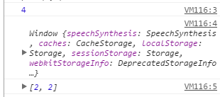
1. Traditional invocation of functions
With traditional invocation of functions, the this keyword has the global scope and refers to the window object
The window object is basically the entire browser
The arguments object is an Array-like object always available within the function corresponding to the arguments passed to the function.
function plus(a,b) {
return (
console.log(a+b),
console.log(this),
console.log(arguments)
)
}
plus(2,2);

Slide 37
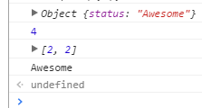
2. Invoking functions as methods of objects
In JavaScript a method is nothing more than a function that has been assigned as a property of an object.
Objects are the most flexible data type, because they can hold any other data type, including other objects and functions.
In the example I created a variable called calc and added two properties, status and a method called plus which was a function.
The this argument is going to point to the object instance that the function is embedded in.
The binding of this is only going to happen at invocation time. So the this attribute is not going to be bound to that object until we invoke the method.
So binding functions to objects and using them as methods is a great programming technique.
var calc = {
status: 'Awesome',
plus: function (a,b) {
return (
console.log(this),
console.log(a+b),
console.log(arguments),
console.log(this.status)
)
}
}
calc.plus(2,2);

Slide 38
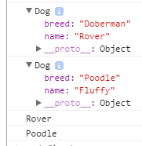
3. Invoking functions as constructors of instances of objects
In the previous slide, we created objects manually by first assigning them to a variable and then adding properties and methods.
Functions in JavaScript can do more than just help you create methods for existing objects.
Functions can create new objects themselves, which is called constructing an object.
You create an object with the new keyword.
This method of creating an object is called a constructor invocation.
new creates a new instance of the object
Each new instance has its own set of properties
Whenever we use the constructor operator new, the this parameter is going to contain a copy of the object instance that we've created.
Convention dictates that constructor names should be capitalized.
A good way of letting developers, and yourself, later on know that this function is a little bit special because it creates an object.
This is JavaScript’s attempt at being somewhat object oriented
var Dog = function(n,b) {
this.name = n;
this.breed = b;
return console.dir(this);
}
firstDog = new Dog("Rover","Doberman");
secondDog = new Dog("Fluffy","Poodle");
console.log(firstDog.name);
console.log(secondDog.breed);

Slide 39

Extending functionality through prototypes
JavaScript is known as a prototypal inheritance language.
That means that you can base the functionality of an object on another object.
Every object can be based on another object
As a matter of fact, every object in JavaScript is based on a different object
That makes it kind of convenient because we don't have to keep on building the same functionality for different things.
The way that we do this is by linking an object's prototype object to another.
With prototypes multiple objects can inherit the same functionality.
With the prototype object, we can expand the functionality of anything in JavaScript.
var speak = function(saywhat) {
console.log(saywhat);
}
var Dog = function(n,b) {
this.name = n;
this.breed = b;
}
var Cat = function(n,b) {
this.name = n;
this.breed = b;
}
Dog.prototype.speak = speak;
Cat.prototype.speak = speak;
firstDog = new Dog("Rover","Doberman");
firstCat = new Cat("Sniggles","Max");
firstDog.speak('woof');
firstCat.speak('meow');

Slide 40
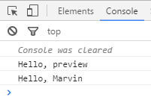
4. Invoking a function with call and apply
The function sayHello rely on its scope for resolving this.name, and calling it without explicit scope will just run them in the scope of the current window
Both call and apply perform very similar functions: they execute a function in the context, or scope, of the first argument that you pass to them
var person1 = {name: 'Marvin', age: 42};
var sayHello = function(){
console.log('Hello, ' + this.name);
};
sayHello();
sayHello.call(person1);

Slide 41
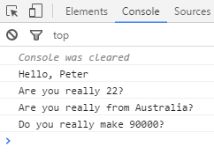
4. Invoking a function with call and apply
Call runs the function in the context of the first argument, and subsequent arguments are passed in to the function to work with.
var person1 = {name: 'Peter', age: 22};
var update = function(nationality, salary){
console.log('Hello, ' + this.name);
console.log('Are you really ' + this.age + "?");
console.log('Are you really from ' + nationality + "?");
console.log('Do you really make ' + salary + "?");
};
update.call(person1, "Australia", 90000);

Slide 42
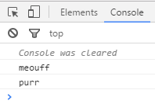
4. Invoking a function with call and apply
The limitations of call quickly become apparent when you want to write code that doesn't (or shouldn't) know the number of arguments that the functions need
So that's where apply comes in - the second argument needs to be an array, which is unpacked into arguments that are passed to the called function.
Both call and apply can be called on functions, which they run in the context of the first argument. In call the subsequent arguments are passed in to the function as they are, while apply expects the second argument to be an array that it unpacks as arguments for the called function.
var speak = function(what) {
console.log(what);
console.log(this.love);
};
var saySomething = {normal: "meow", love: "purr"};
speak.apply(saySomething, ['meouff']);

Slide 43
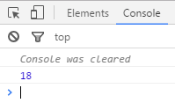
The arguments parameter
Often you will pass a specific number of elements to functions
Oftentimes, you either don't know how many elements you'll be needing to pass to a function or you want your function to be able to accept any number of elements.
For that we can use a special object available to functions called the arguments parameter.
The job of the arguments parameter is to hold a list of all the elements passed as arguments to the function.
the arguments parameter is an array-like object, because it looks like an array and can do some of the things that we can do to arrays.
var plus = function() {
var sum = 0;
for (var i = arguments.length - 1; i >= 0; i--) {
sum += arguments[i];
};
return sum;
}
console.log(plus(2,2,2,3,2,3,4));

Slide 44
Anonymous closures
//traditional function declaration and invocation
function kung() {
console.log('foo');
}
kung();
//anonymous function
var iKnow = function () {
console.log('foo');
}
iKnow();
//letting the function execute itself
var iKnow = function () {
console.log('foo');
}();
//will not work
function() {
console.log('foo');
}();
//self-executing function or anonymous closure
(function() {
console.log('foo');
})();
When you use the function keyword, JavaScript assumes that you want to create a function with a name. But it's not going to run it. Think of an expression like a formula.
Adding parenthesis we're asking JavaScript to think of our function as a formula that needs to be processed so it can be invoked immediately.

Slide 45
Creating and namespacing modules
<!doctype html>
<html lang="en">
<head>
<meta charset="UTF-8">
<title>JavaScript Modules</title>
</head>
<body>
<script src="module.js"></script>
<script>
myModule.speak();
</script>
</body>
</html>
Modules divide programs into clusters of code that, by some criterion, belong together.
Modules let you reuse code across different applications
The first thing you do whenever you create any module is create a namespace for it.
Namespacing allows you to protect any variables that you have in your modules from any global scoped variables.
Howto:
use a return statement that allows you to communicate back with the rest of the application
instead of returning a statement, we can return an object, and through the object we can create variables and functions.
The key thing to note is that we've added namespace which is going to protect the content within the module from any other global variables.
var myModule = (function() {
var name = "John";
return {
speak: function() {
console.log('hello, I\'m ' + name);
},
run: function() {
console.log('I\'m running');
}
};
})();

Slide 46
Code Reuse
Putting pieces of functionality that stand on their own into separate files and modules makes them easier to track, update, and share because all the various pieces of code that want to use the module load it from the same actual file.
This idea gets even more powerful when the relations between modules—which other modules each module depends on—are explicitly stated. You can then automate the process of installing and upgrading external modules (libraries).
An online service that tracks and distributes hundreds of thousands of such libraries, allowing you to search for the functionality you need and, once you find it, set up your project to automatically download it is extremely useful.
NPM consists of an online database of modules and a tool for downloading and upgrading the modules your program depends on (npm is the package manager for JavaScript).
It grew out of Node.js, the browserless JavaScript environment we will discuss soon in the course

